Slide 1
AUTOMATED CODE REVIEW SYSTEM
Presented By:
Ahmed Musab
Muhammad SHARIQ

Slide 2
AGENDA
What is Automated Code Review System?
What it detects
How it works?
Which tools used?
Future Enhancements

Slide 3
What is Automated Code Review System?
It’s a simple Python-basd web tool which checks whether the prompted code is correct or does it have any error. If error is there, it displays a pop up whats wrong in the code.
What it detects?
Unused variables
Infinite loops
Duplicate function names

Slide 4
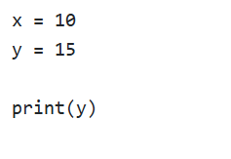


EXAMPLES
Unused Variable Detect
Error:

Slide 5
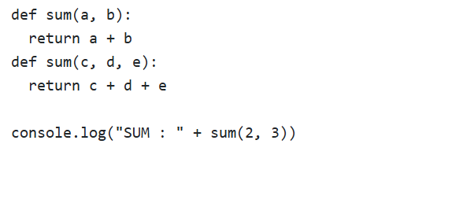


Duplicate Function Name
Error

Slide 6



Inverted Commas Check
Error

Slide 7
How it works?
On front-end, there is a web-based interface where user inputs any kind of python code to check and on back-end, there is a flask server which:
parses the code using Python’s AST (Abstract Syntax Tree).
Applies regex rules to detect patterns.
Returns actionable feedback to the user through a responsive web-based interface.
Key Features
Light-weight and fast i.e. No execution needed.
Easy to add new checks
Beginner-friendly

Slide 8

Which tools used?
Front-end:
HTML / CSS
Bootstrap
JavaScript
Back-end:
Python
Analysis:
AST parsing
Regex

Slide 9
Future Enhancements
AI – powered suggestions
Explain detected issues
eg. "Try: Use consistent quotes → print(\"Hello World\")”
Auto-fix Capability
eg. Add a fix all buttons that fixes all the bugs.

Slide 10


